Slide 1
SELL SMART
STAY SAFE
Preparing to Open

Slide 2
NVDISPENSE.COM
Table of Contents
PAGE 3
4
5
6
8
Preventing the Spread of COVID-19 is Nevada’s Primary Concern
Implementing CDC Guidelines For Prevention of Spread of Covid-19
Ongoing Guidelines For Prevention of Spread of Covid-19
Federal Guidance to Employers
Changing Operations
PAGE 10
11
12
13
14 15
Training Employees
Express Pickup By Appointment Only
Curbside Accommodations
Drive-Through Service
Commitments to Go Above and Beyond to Prevent Spread
How Other States are Dealing with Access to Cannabis

Slide 3
NVDISPENSE.COM
Preventing the Spread of COVID-19 is Nevada’s Primary Concern
While focusing on preventing the spread of COVID-19, dispensaries can incrementally get their employees back to work by strictly adhering to one or more of the following proposals, if allowed by the State.
This will help ensure medical patients (with or without cards) are able to obtain cannabis, which is difficult through delivery only as the industry can only meet a portion of the demand through delivery.
The NDA submits that allowing dispensaries to reopen under guidelines issued to maximize prevention of spread of COVID-19 would be optimal. If the State chooses to allow opening in phases, curbside, drive-through, and express pickup options could also be utilized in a manner that maximizes CDC guidelines. Regardless of which path the State chooses, incremental opening or opening with strict guidelines, the NDA supports strict adherence to guidelines issued to prevent the spread of COVID-19.

Slide 4
NVDISPENSE.COM
Implementing CDC & State Guidelines for Prevention of Spread of Covid-19
In addition to current sanitation and hygiene regulations (click to view), cannabis establishments will implement CDC guidelines on prevention of spreading COVID-19.
Implementing CDC guidelines involves two main facets:
Changing Operations
Employee training
Each dispensary must stay apprised of changes in CDC guidelines on preventing the spread of COVID-19 (such as the change in the guidance to wear a mask). Guidelines include the following and can be accessed in full by clicking here:
How to wear a cloth face covering
CDC directions for homemade coverings, including washing as well as sew and no sew instructions

Slide 5
NVDISPENSE.COM
Ongoing Federal and State Guidelines and Requirements for Reopening
Cannabis Establishments must follow all State and Federal guidelines for reopening including, but not limited to:
Any guidance issued by Governor Sisolak related to reopening.
White House guidelines issued on April 16, 2020, including the following guidance to employers and any new guidance issued going forward.

Slide 6
NVDISPENSE.COM
Federal Guidance to Employers
Develop and implement appropriate policies, in accordance with Federal, State, and local regulations and guidance, and informed by industry best practices, regarding:
Social distancing and protective equipment
Temperature checks
Testing, isolating, and contact tracing
Sanitation
Use and disinfection of common and high-traffic areas
Business travel
Monitor workforce for indicative symptoms. Do not allow symptomatic people to physically return to work until cleared by a medical provider.
Develop and implement policies and procedures for workforce contact tracing following employee COVID+ test.

Slide 7
NVDISPENSE.COM
Federal Guidance to Employers: Phase One
Continue to encourage telework, whenever possible and feasible with business operations.
If possible, return to work in phases.
Close common areas where personnel are likely to congregate and interact, or enforce strict social distancing protocols.
Minimize non-essential travel and adhere to CDC guidelines regarding isolation following travel.
Strongly consider special accomodations for personnel who are members of a vulnerable population.

Slide 8
NVDISPENSE.COM
Changing Operations
Hand sanitizer available to employees and customer near doors and point of sale.
Employee training on proper wearing and disposal of gloves.
Team members wear masks per CDC guidelines (cloth if not sick or vulnerable population).
Team members are reminded daily to not touch their face and are trained on all hygiene and handwashing regulations.
Establishment follow all local, state, and Federal guidelines on social distancing, including not allowing sick employees to work and guidelines on when they can return to work.
Enhanced cleaning and sanitation checklist completed as necessary:
Clean & disinfect frequently touched surfaces such as tables, doorknobs, light switches, countertops, handles, desks, phones, keyboards, toilets, faucets, and sinks.

Slide 9
NVDISPENSE.COM
Changing Operations (cont’d)
Evaluate and remove all unnecessary customer touch-points prior to reopening, including:
Do not use reusable menus
Remove pamphlets
Remove unnecessary surfaces from POS terminal
Remove sample jars
Remove testers (CBD)
*These measures would be temporary up and until the spread of COVID-19 is no longer a concern.

Slide 10
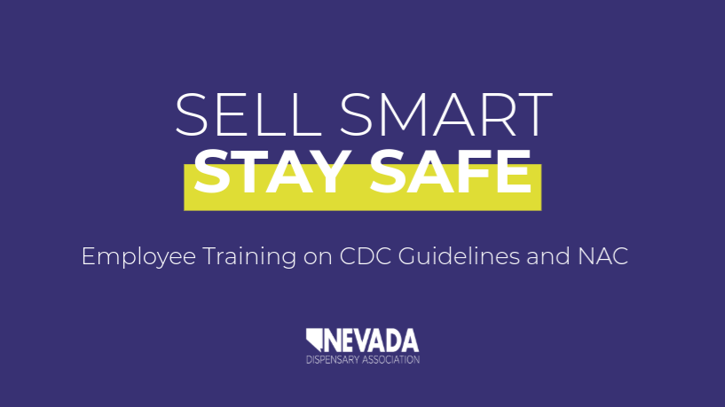
NVDISPENSE.COM
Training Employees
Training curriculum adapting CDC Guidelines to practical application in dispensaries while adhering to Nevada Administrative Code has been made available to Nevada dispensaries and is available for review.
Click here or below to view and download the Employee Training.

Slide 11
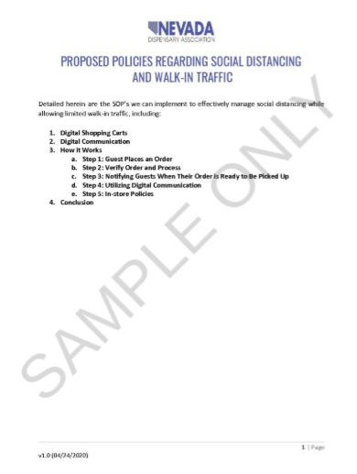
NVDISPENSE.COM
Express Pickup by Appointment Only
Customer places order online or over the telephone.
Dispensary provides a window of when to arrive to pick-up product.
Dispensaries do not allow lines to form around outside of building and only allow as many people in the store as will allow for 6 foot separations.
Point of Sale stations that are being used are 6 feet apart.
Additional procedures to prevent the spread of COVID-19 previously discussed.
Click here or below for a sample SOP.

Slide 12
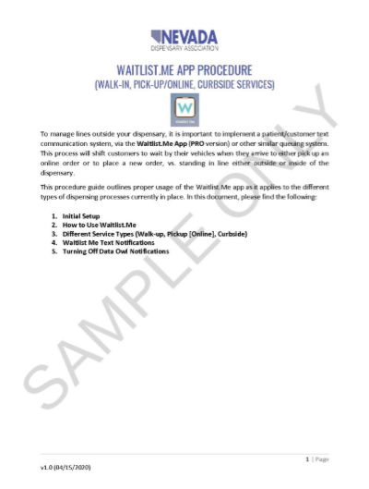
NVDISPENSE.COM
Curbside Accommodations
Include a vehicle in definition of private residence and allow delivery on dispensary parking lot.
Implement queuing system (ex. waitlist me app)
This method is as sanitary as home delivery and allows more transparency and control.
Procedures to Prevent Spread of COVID-19:
Customers do not exit their vehicle.
Security is stationed outside the store during open hours to ensure people do not congregate outside.
Additional Procedures to Prevent Spread of COVID-19 previously discussed.
Example operating procedure here. Example only, would need to be adapted by each store (click to view in full).

Slide 13
NVDISPENSE.COM
Drive-Through Service
State regulations do not prevent cannabis establishments from offering drive through services, although some local governments do.
When dispensaries are allowed to reopen, one way to promote social distancing is to allow drive through service.
Any dispensary conducting drive-through service must at a minimum:
Utilize sneeze guards at a drive-through window
Not allow patrons of the drive-through service to exit their vehicle
Implement procedures discussed in “changing operations” slide.

Slide 14
SELL SMART
STAY SAFE
Riana Durrett, Esq. riana@nvdispense.com | 702.782.4180

